Slide 1
Dying, Death and Grief as Part of Life
Opening Our Hearts To The Inevitable
Anne Stewart, B.A., IEN
Registered Social Service Worker
Grief Support, End-of-Life Guidance, Death Doula Services
June 4th, 2026
Family Council Ontario

Slide 2
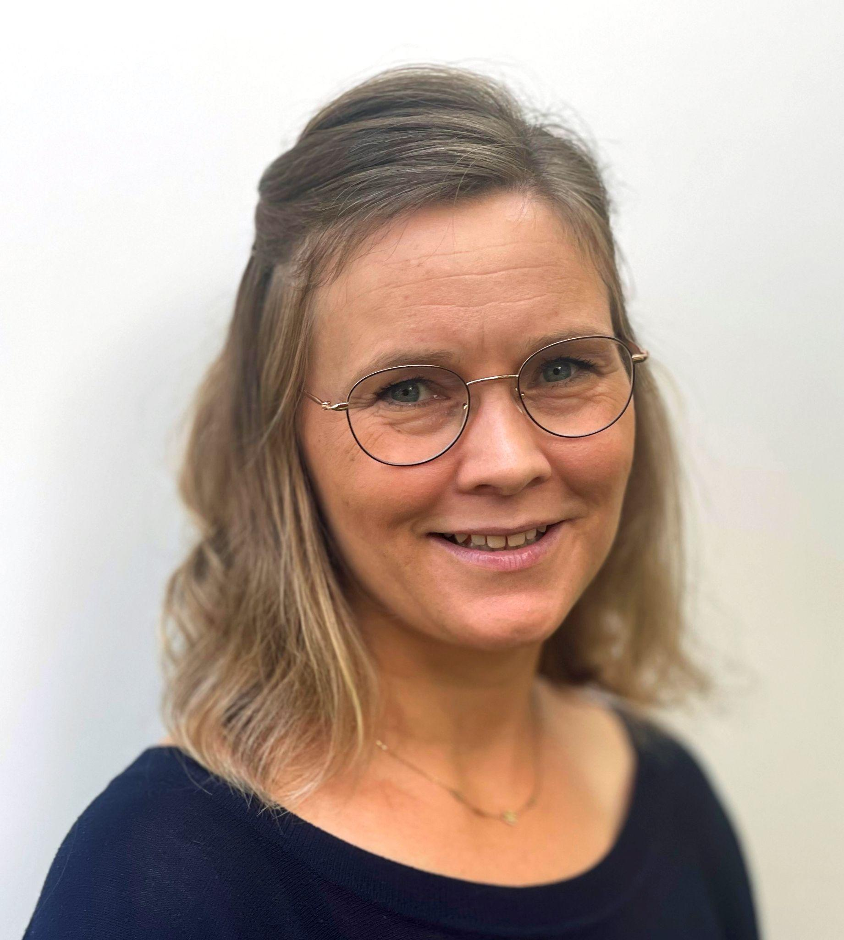
Anne Stewart
Founder Holding Space Halton
offering
Grief Support
End-of-Life Guidance
Death Doula Services
Registered Social Service Worker
Internationally Trained Nurse
HHA certified Death Doula
Postgraduate studies in Thanatology
Last Aid® Facilitator with CHPCA
North Halton Hospice Awareness Committee Member
Lecturer at Sheridan College
Therapeutic Touch Practitioner I.T.

Slide 3

What gets
me out of bed?
…and why am I here?
Vision: dying well
Empowering individuals and the community
Death literacy & education
No matter where death occurs - family and friends can take on an important role and contribute to the outcome
Normalizing difficult conversations
Notes:
“Chain of Palliative Care” vs. “Chain of Survival”
Caring for the dying is not done alone: supporting the individual within their physical, psycho-social, emotional and spiritual domain of care.

Slide 4

Today’s presentation
Dying as a normal part of life
The importance of planning ahead
Grief - a deeply personal experience
Conversations about Dying, Death & Bereavement: Death Cafés

Slide 5

Dying as a Normal Part of Life
Notes:
Impermanence
Our own mortality
Knowing versus something actually happening
Acknowledging and living in the present moment
Meaning Making
Leaving a Legacy

Slide 6
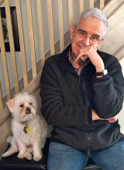
Balfour Mount (1939 - 2025)
The father of Palliative Care in Canada
Notes:
Balfour Mount, deeply committed to palliative care, has been instrumental in in the establishment of palliative care services, research and teaching in Canada. He is the founding Director of the Royal Victoria Hospital Palliative Care Service, Palliative Care McGill, and the McGill Programs in Integrated Whole Person Care.

Slide 7
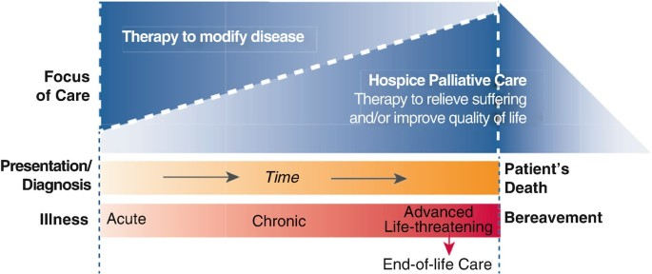
Hospice Palliative Care Philosophy
in Canada
Notes:
Overall Access: Approximately 58% of Canadians who died in 2021-2022 received palliative care.
Trends: More Canadians dying at home with palliative support.
Barriers: Access to palliative care can be challenging for certain groups, including those in smaller communities, individuals of certain ages, and those with specific disease diagnoses.
Capacity Issues: Canada lacks the capacity to consistently deliver palliative care, particularly in hospice settings, and doesn't meet best practice recommendations for hospice beds per capita.
Early Palliative Care: Early palliative care is still underused, despite its potential benefits.

Slide 8
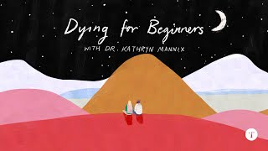
How do I recognize that someone might be approaching the end of life?
Social withdrawal
Loss of interest in the world around them
Less food & fluid intake
Fatigue that more sleep can’t alleviate
More sleep time, less awake time
Longing for peace and reconciliation

Slide 9
How do I recognize that someone is actively dying?
Less responsive
Changes in breathing and circulation
Build up of fluid in the lungs
Altered skin tone
Change in body temperature
Urinary and bowel incontinence
Discoloration of urine
Altered level of consciousness
Nearing Death Awareness
* Dying is deeply unique.
These signs are common but can vary, and all, none or some can be present.

Slide 10
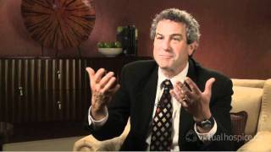
Saying Goodbye
Talk openly about death
Listen to the dying person
Use the time to:
  express love
  share memories
  seek forgiveness

Slide 11





The Importance of Planning Ahead

Slide 12

What is
Advance Care Planning?
Advance Care Planning (ACP) is a process of reflection and communication where individuals express their wishes about future healthcare decisions in the event, they become incapable of consenting to or refusing treatment or other care.
ACP = understanding values, choosing a decision-maker, documenting wishes.
Applies to all adults, not just older adults or those with illness.

Slide 13

Why Advance Care Planning
makes sense
Ensures care aligns with personal values
Reduces stress for loved ones
Improves end-of-life care quality
Profound act of self-reflection and a gift to our loved ones
Illness & death are part of life: avoiding conversations doesn’t make life events unhappen

Slide 14
In Ontario, ACP involves:
Identifying your Substitute Decision Maker
Having meaningful conversations about your values and beliefs
Documenting wishes to guide future healthcare decisions
Think
What matters most to you?
Who could make healthcare decisions for
you if you
cannot?
Talk
Discuss your thoughts with:
Those closest to you;
Your health-care providers
Review
Plan
Record your wishes &
Share your plan with those closest to
you & your health care providers

Slide 15
Key Requirements for a SDM
Willing and Able
Must be willing and able to make healthcare decisions on your behalf
Honours your Wishes
Committed to honouring your wishes, even if different from what they would choose for themselves.
Mentally Capable
Able to speak for you even under stressful circumstances.
Age Appropriate
At least 16 years old in Ontario
Availability
Must be available to make decisions when needed

Slide 16
Communication about serious illness, dying, death and grief
Acknowledging the challenge
The importance of open communication
Respect Readiness and Silence
Family/friends/others:
“Would it be ok to talk to you about…”
“I don’t know what to say, but I am here.”
Individual:
“I am not getting better, am I?”
“I am afraid.” or “I am worried.”

Slide 17






The Advance Care Planning Process
Identify Your SDM
Determine who will speak for you when you cannot, considering the hierarchy or appointing someone through a Power of Attorney for Personal Care.
Reflect on Values & Wishes
Consider what matters most to you regarding your healthcare, quality of life, and end-of-life care.
Have meaningful conversations
Share your wishes with your SDM(s), loved ones, and healthcare providers.
Document your Wishes
Complete relevant documentation like a Power of Attorney for Personal Care and Advance Care Planning Workbook.
Review Regularly
Revisit your plans as your health, relationships, or preferences change.

Slide 18
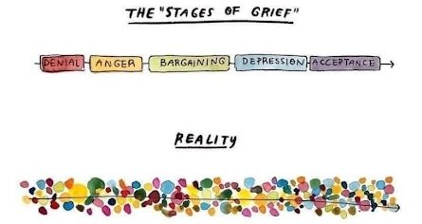
Grief - a Whirlwind of Emotions

Slide 19
Reactions to loss*
Emotional Reactions
  Sadness
  Anger
  Loneliness
  Guilt
  Hopelessness
Physical Reactions
  Sleep disturbances
  Crying
  Lack of energy
  Headache
  Social Withdrawal
Cognitive Reactions
  Confusion
  Distractibility
  Inability to make decisions
  Feelings of unreality
  Search for meaning
* this is not a complete list

Slide 20
Living Well with Grief
Grief is unique and ongoing
It’s about learning to live with and manage your grief over time
It’s about moving forward through connection
All feelings experienced are natural and valid - don’t dismiss
Allow space for the emotions
There are no “good” or “bad” feelings - honour them and do what is right for you

Slide 21
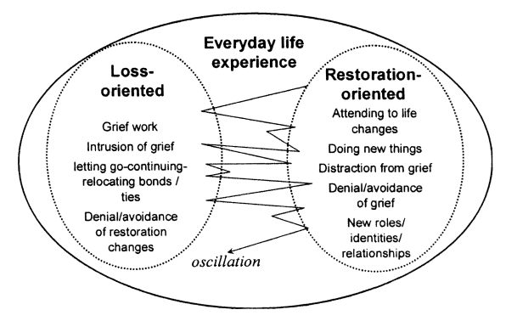
The Dual Process Model of Coping with Bereavement
The Dual Process Model of Coping with Bereavement (Stroebe & Schut, 1999).

Slide 22

Self-care 🤍
when times are tough
Rest and good sleep
Eat nourishing meals
Stay physically active
Connect with supportive people
Allow yourself to feel emotions

Slide 23

Coping
when times are tough
Talk about your feelings
Maintain routines and structure
Express through writing, art, or music
Spend time in nature or quiet reflection
Reach out for support when needed
SLOW DOWN

Slide 24
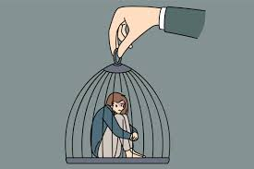
When extra help may be needed in grief
Struggling with daily life
Intense or prolonged emotions
Withdrawing or isolating
Harmful coping behaviors
Thoughts of hopelessness/self-harm
See it or worried? Say something!

Slide 25
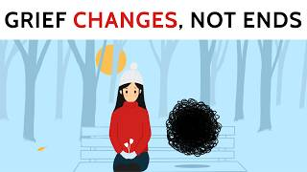

Slide 26

Death Café - Where Curiosity Matters
A Death Café is a group-directed discussion about death with no agenda or objectives
First organized by Jon Underwood in 2011
Usually held in informal settings like cafés, community centers, or homes
Not a support group or grief counseling session
Sharing of experiences and getting questions answered
Holding a conversation or discussion with a focus on a less often
discussed topic

Slide 27

What happens at a Death Café?
Open, respectful conversations about death and dying
No specific theme - topics come from participants
Often includes tea, coffee, and cake to create a relaxed atmosphere
Everyone is encouraged to share, but listening is equally valued
Common discussion topics:
Fear of death
Cultural attitudes toward dying
End-of-life planning
Personal experiences with loss

Slide 28

Why do people attend?
To talk openly about a topic often considered taboo
To reflect on life, meaning, and mortality
To reduce fear and anxiety around death
To connect with others in a supportive environment

Slide 29
Your Turn!

Slide 30

Any QUESTIONS
are welcome!

Slide 31
THANK YOU
so much for sharing your time with me!
Contact:
Frauke Anne Stewart, B.A., RSSW
Holding Space Halton
Principal & Founder
Website: www.HoldingSpaceHalton.ca
Email: info@HoldingSpaceHalton.ca
Phone: (416) 705 - 3678

