Slide 1


Building Capacity to Support Person-Centred Care and Culture Change in LTC
Presenters:
Lindsay Passfield-Leu, VP Clinical Programs and Quality, Osgoode Care Centre
Michelle Fleming, Senior Knowledge Broker, Ontario CLRI at Bruyère Health
Family Councils Ontario Conference - East Region
Tuesday, May 19th, 2026
‹#›
CLRI-LTC.CA

Slide 2


Introductions
Lindsay Passfield-Leu
VP Clinical Programs and Quality
Osgoode Care Centre
Michelle Fleming
Senior Knowledge Broker
Ontario CLRI at Bruyère Health
‹#›
CLRI-LTC.CA

Slide 3



ACKNOWLEDGEMENT
The Ontario CLRI at Bruyère Health would like to acknowledge the partnership of Osgoode Care Centre.
This work is supported in part with funding from the Government of Ontario through the Ontario Centres for Learning, Research and Innovation in Long-Term Care. The views expressed herein do not necessarily reflect the views of the Province.
‹#›
CLRI-LTC.CA

Slide 4


WHAT WE DO
EDUCATION
INNOVATION
RESEARCH
EVIDENCE-BASED CARE DELIVERY
COLLABORATION
KNOWLEDGE
‹#›
CLRI-LTC.CA
Notes:
The Ontario Centres for Learning, Research and Innovation in Long-Term Care strengthens quality of life and care for residents across the province. We are a program of the Ministry of Health and Ministry of Long-Term Care that acts as a resource for the sector to enhance the health and well-being of people who live and work in long-term care.
We do this by:
providing education and training
sharing research and innovations
identifying and developing resources for LTC homes
The Program partners with the LTC sector to provide solutions for priority issues, including mental health, EDI and future workforce engagement.
We are hosted at three different sites: Baycrest Health Sciences, Bruyère Health, and the Schlegel-UW Research Institute for Aging.
‹#›

Slide 5


HOST ORGANIZATIONS
The Ontario CLRI is funded by the Government of Ontario and hosted at Baycrest, Bruyère Health, and the Schlegel-UW Research Institute for Aging. The collective expertise, resources and partnerships help advance our provincially mandated goals.
BAYCREST
Baycrest is a global leader in geriatric residential living, healthcare, research, innovation and education, with a special focus on brain health and aging.
BRUYÈRE HEALTH
Maximizing quality of life and helping people stay and return home, Bruyère Health offers a variety of services in aging and rehabilitation, medically complex, palliative, residential and primary care.
SCHLEGEL-UW RESEARCH INSTITUTE FOR AGING (RIA)
The RIA is an innovation catalyst. By advancing research, education and practice, the RIA enhances quality of life and care for older adults everywhere.
‹#›
CLRI-LTC.CA
Notes:
The Ontario CLRI was tasked by the Ministry of Long-Term Care to coordinate its outreach to LTC homes in the province. Although the program is situated across three host organizations, we have developed a single program profile and capitalized on the expertise across host organizations to be an effective resource program for Ontario LTC homes and the sector.
‹#›

Slide 6

What is Person-Centred Care?
  Philosophy of Care
  Ensures that the resident is a partner and active participant in their care
  Resident’s goals, needs, and preferences drive decision-making for care
  Families and caregivers play a critical role in supporting Person-Centred Care
‹#›
CLRI-LTC.CA
Notes:
‹#›

Slide 7

Person-Centred Care Concepts
  The resident is the best expert in their own life
  Builds on the person’s strengths
  Flexibility and choice
  Autonomy and the right to live at risk
  Values compassion, respect, dignity, trust and meaningful quality of life
  Partners with resident and the people that are closest to them and matter most to them
‹#›
CLRI-LTC.CA

Slide 8



‹#›
| CLRI-LTC.CA

Slide 9
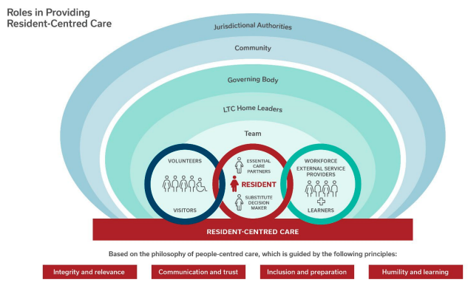
‹#›
Source: Health Standards Organization. National Long-Term Care Services Standard. January 2023.
CLRI-LTC.CA

Slide 10

‹#›
| CLRI-LTC.CA

Slide 11
Culture Change
  Shift away from institutional / medical / task-oriented model, towards person-centred, social and emotion-based model of care
  Multiple different models out there -
    Butterfly (Meaningful Care Matters)
    Eden Alternative
    Green House
    Hogeweyk Village Dementia Village
‹#›
CLRI-LTC.CA
Notes:
‹#›

Slide 12

Tools and Supports for
LTC Homes
‹#›
CLRI-LTC.CA

Slide 13
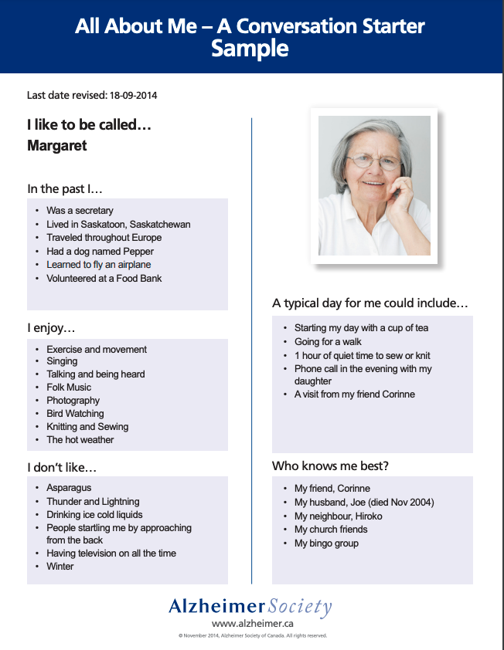
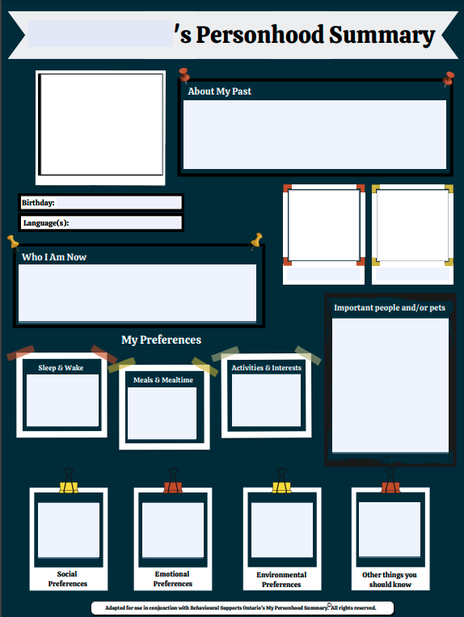
Tools to Support Person-Centred Care
My Personhood Summary Poster templates (Behavioural Supports Ontario)
All About Me, Conversation Starter (Alzheimer Society of Canada)
‹#›
CLRI-LTC.CA

Slide 14
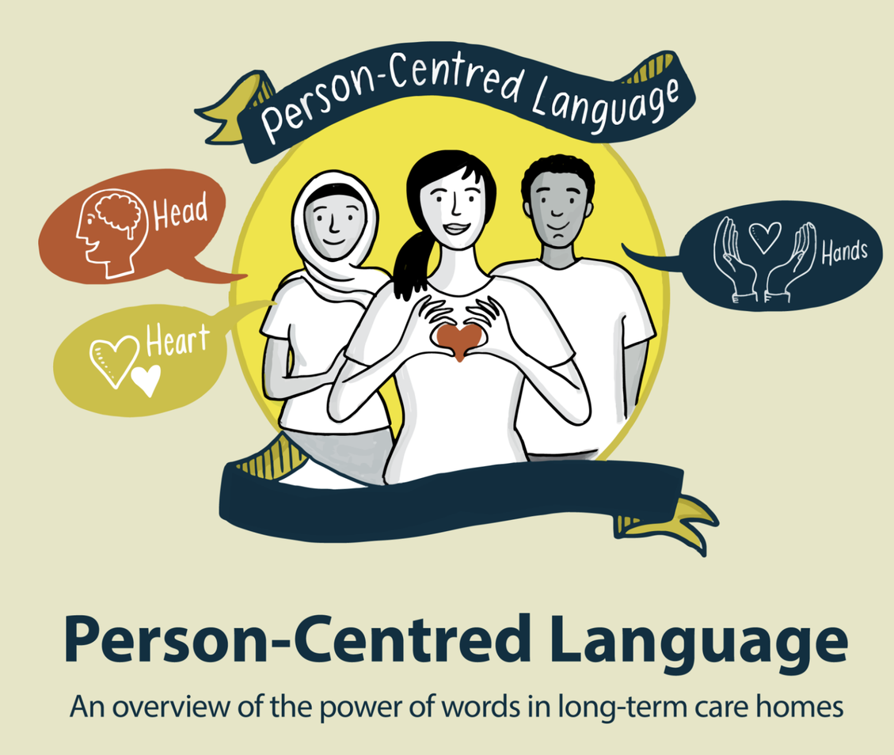
Tools to Support PCC
  Person-Centred Language puts the person first
  Respectful language that eliminates institutional and infantilizing language
  Suite of resources including eLearning, posters, toolkit and Pledge
  Partnership between the Ontario CLRI at the RIA and Behavioural Supports Ontario
Person-Centred Language Resources
‹#›
CLRI-LTC.CA

Slide 15
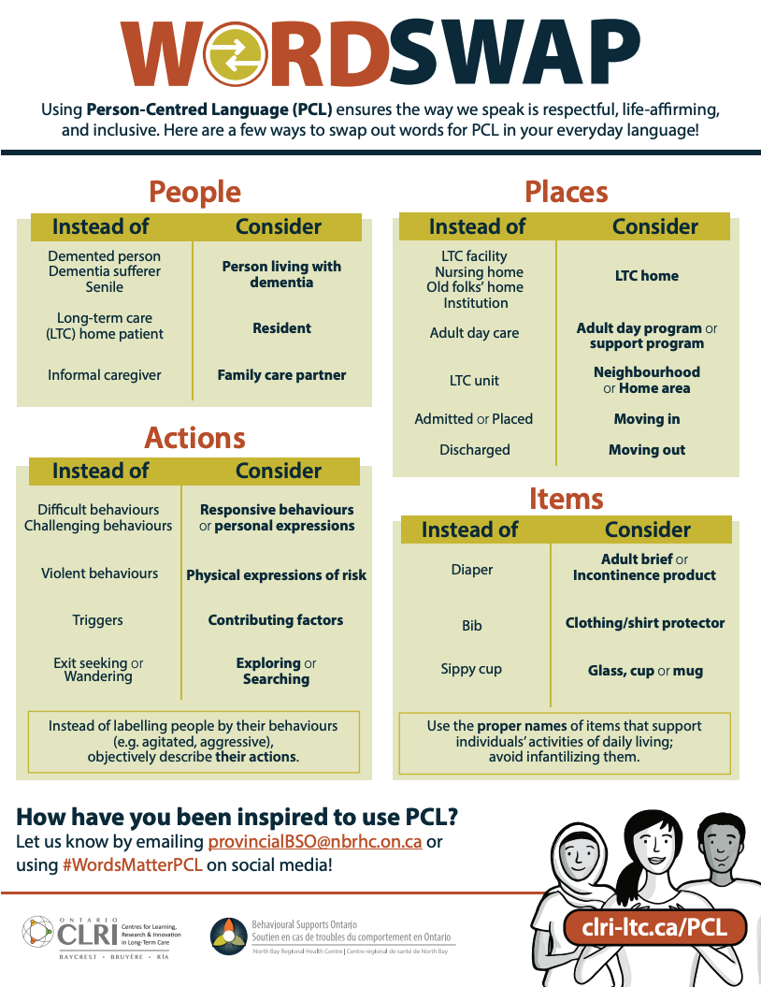
‹#›
CLRI-LTC.CA

Slide 16
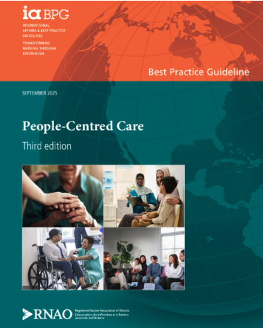
RNAO’s Best Practice Guideline: People-Centred Care
Provides evidence-informed recommendations, including:
    Establish therapeutic relationships grounded in trust, respect, trauma-informed care and cultural safety
    Co-design individualized care plan that reflect a person’s values, goals, needs and preferences
    Support advance care planning by assessing readiness and facilitating discussions over time
    Tailor care environments and approaches (e.g., sensory needs) based on individual preferences and needs
    Center care on the whole person
‹#›
https://rnao.ca/bpg/guidelines/people-centred-care
CLRI-LTC.CA

Slide 17


Community of Practice for
LTC homes
  Began in Champlain Region in 2019
  Launching to a provincial audience in June!
  Virtual sessions to support peer learning between LTC home leaders and team members
Learn more: https://clri-ltc.ca/resource/pcc-ltc-cop/
‹#›
CLRI-LTC.CA

Slide 18

“Healthy norms are created when a strong sense of belonging is present. Create a feeling of belonging by integrating people of various levels of care, various levels of dementia. When people got to know each other as human beings, they stopped focusing on different abilities.”
  Jill Vitale-Aussem
‹#›
| CLRI-LTC.CA

Slide 19
Culture Change in Action
‹#›
CLRI-LTC.CA

Slide 20

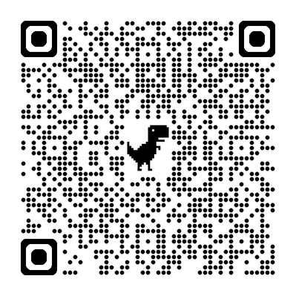
Learn more about the Glebe Centre’s Journey: https://clri-ltc.ca/empowering-life-stories-connection-and-individuality-the-glebe-centres-journey-of-becoming-a-butterfly-ltc-home/
‹#›
CLRI-LTC.CA

Slide 21
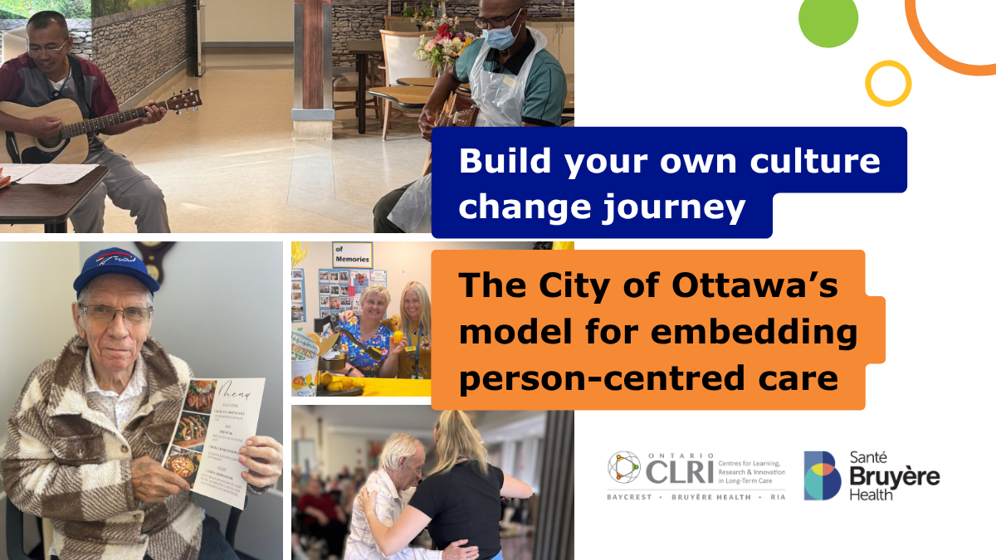

Learn more about the City of Ottawa’s Journey: https://clri-ltc.ca/build-your-own-culture-change-journey-the-city-of-ottawas-model-for-embedding-person-centred-care/
‹#›
CLRI-LTC.CA

Slide 22
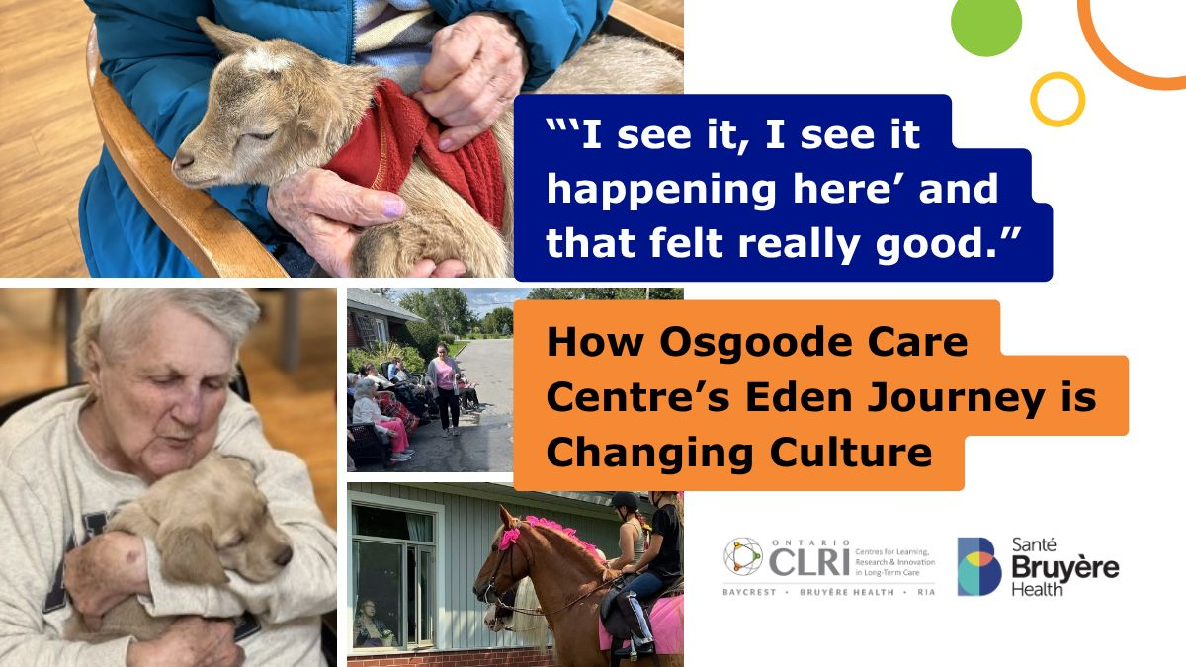
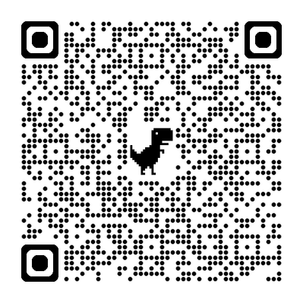
Learn more about Osgoode Care Centre’s Journey: https://clri-ltc.ca/i-see-it-i-see-it-happening-here-and-that-felt-really-good-how-osgoode-care-centres-eden-journey-is-changing-culture/
‹#›
CLRI-LTC.CA

Slide 23


Slide 24
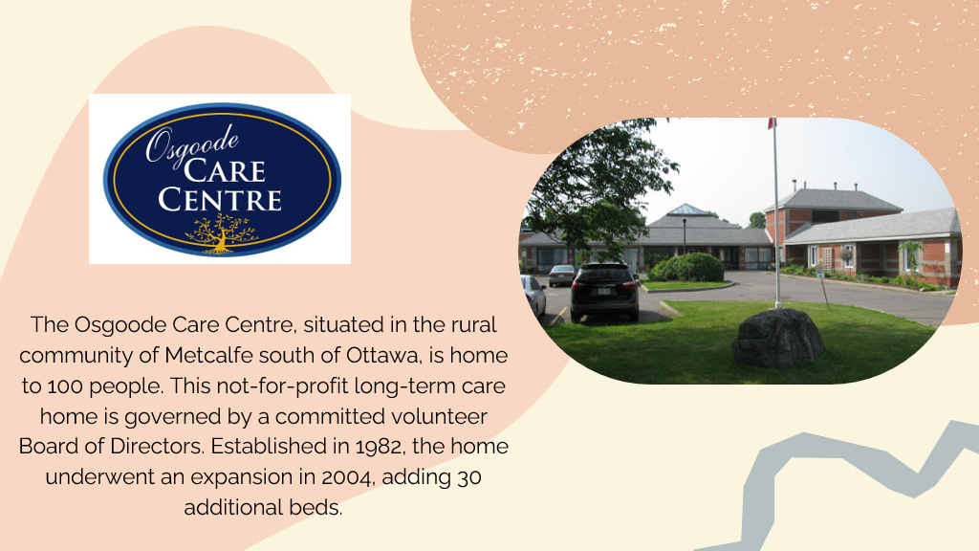

Slide 25


Slide 26
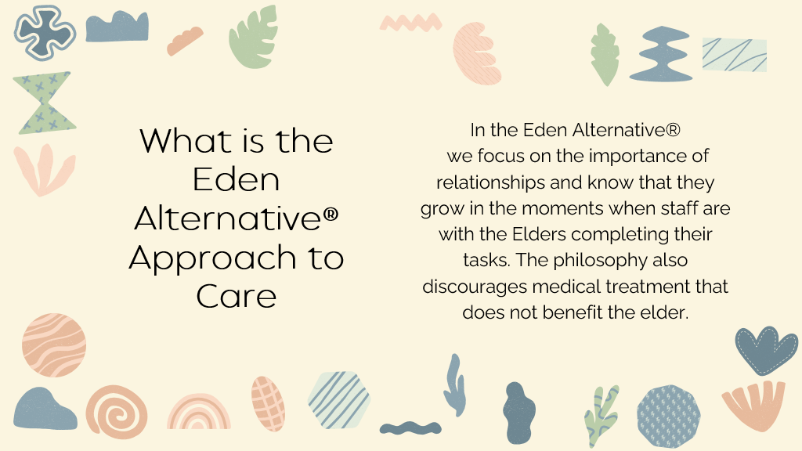

Slide 27
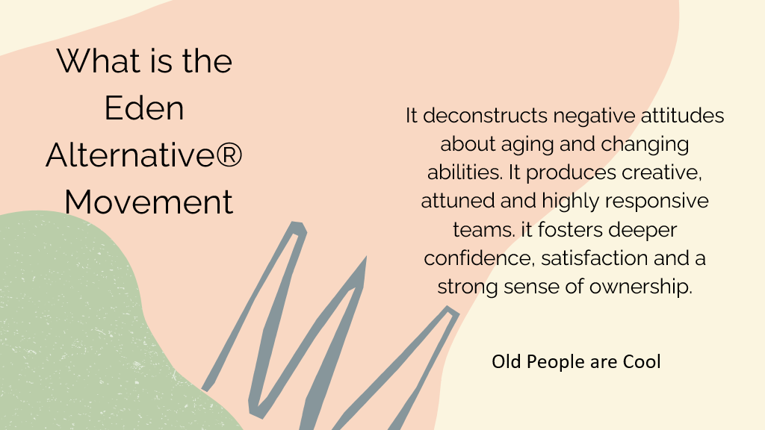

Slide 28


Slide 29
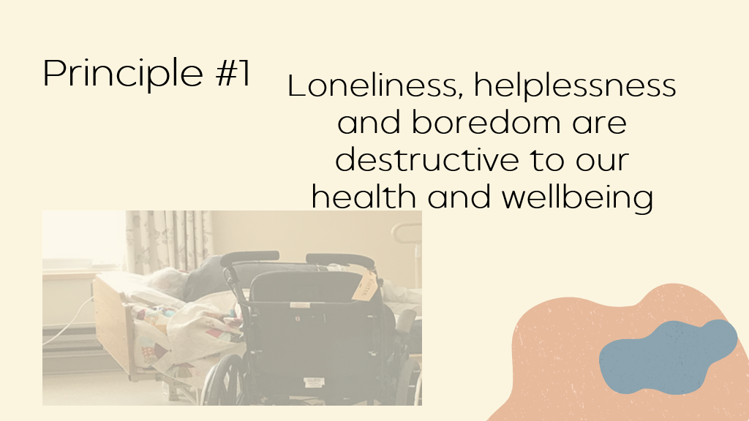

Slide 30
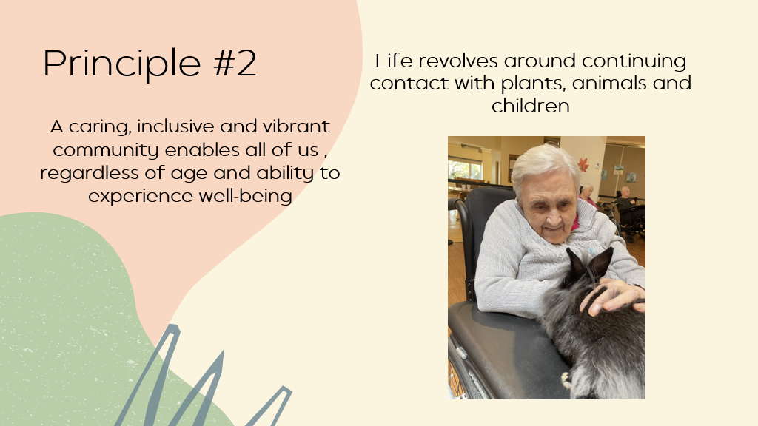

Slide 31
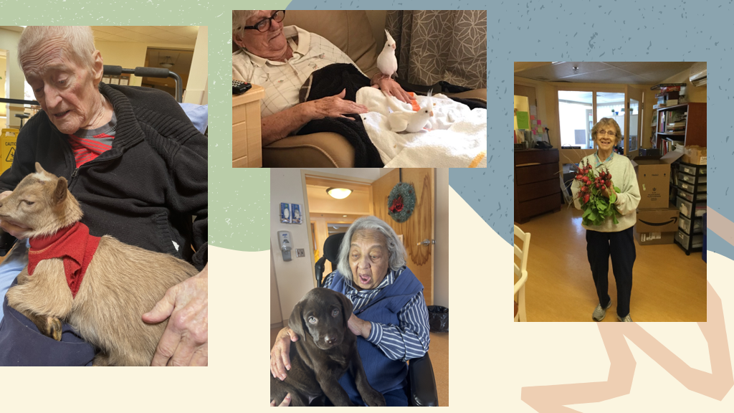

Slide 32
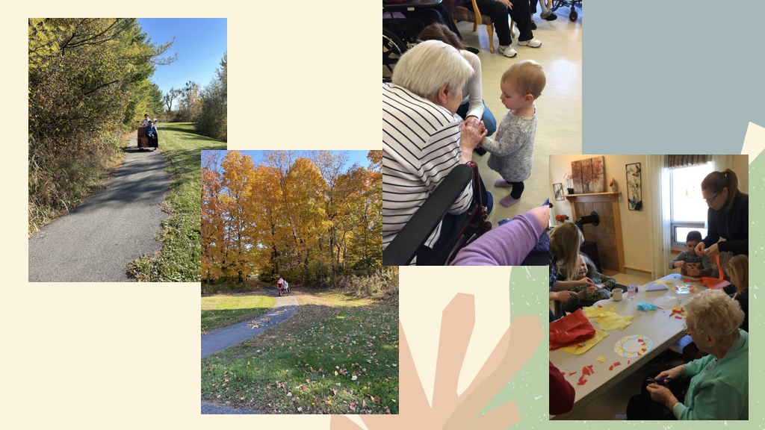

Slide 33
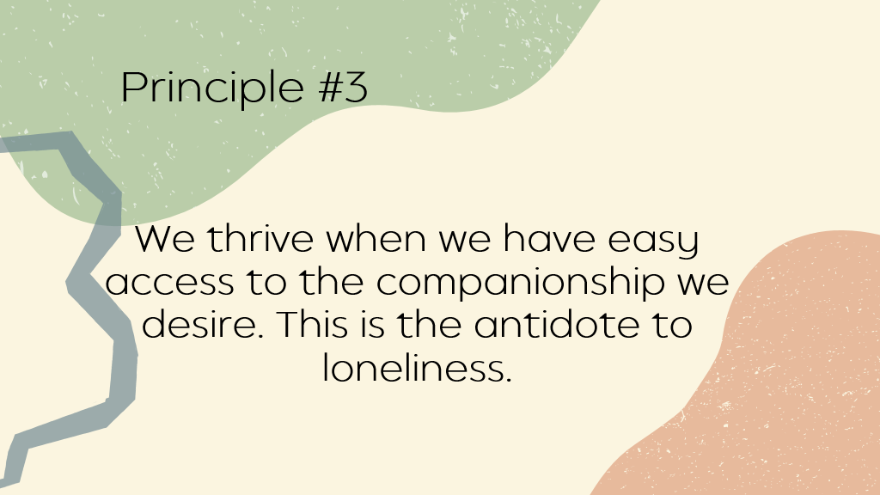

Slide 34
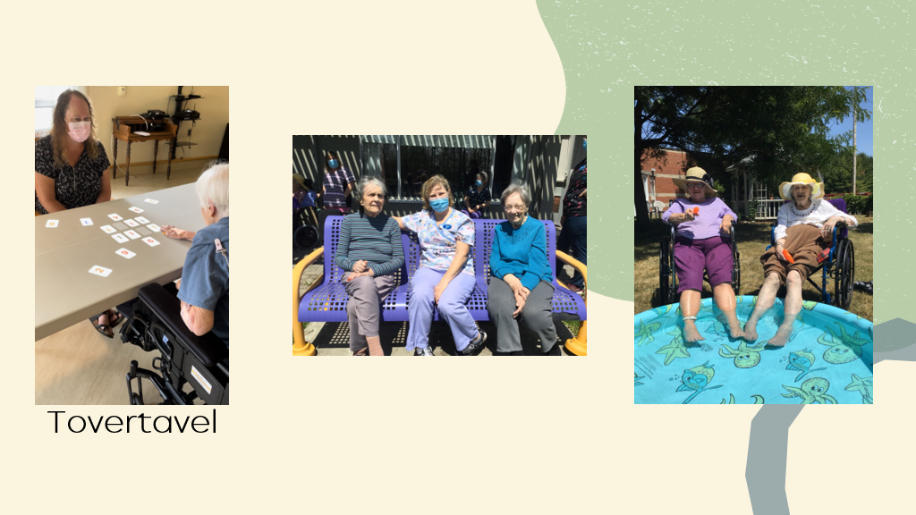

Slide 35
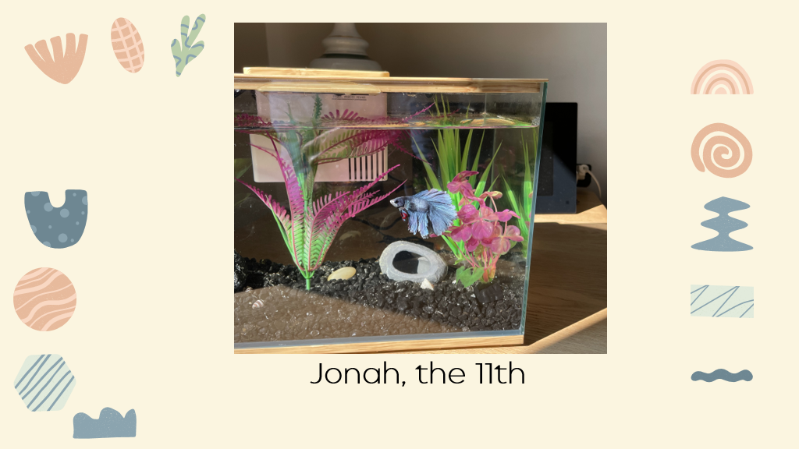

Slide 36
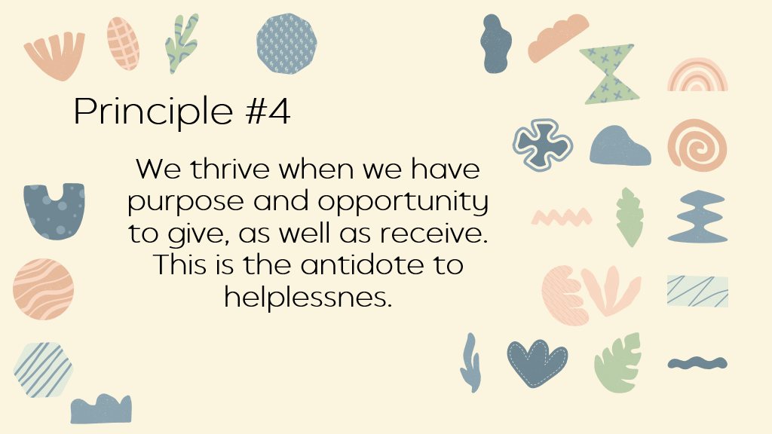

Slide 37
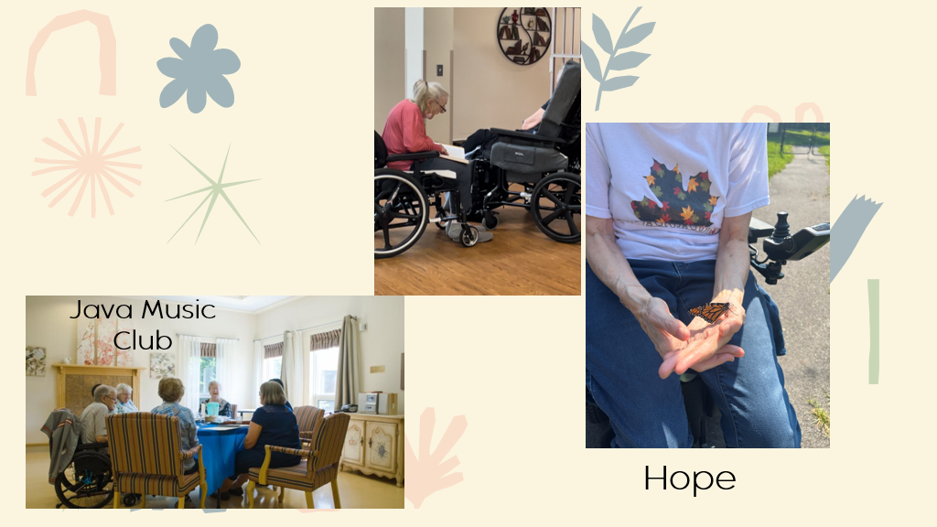

Slide 38
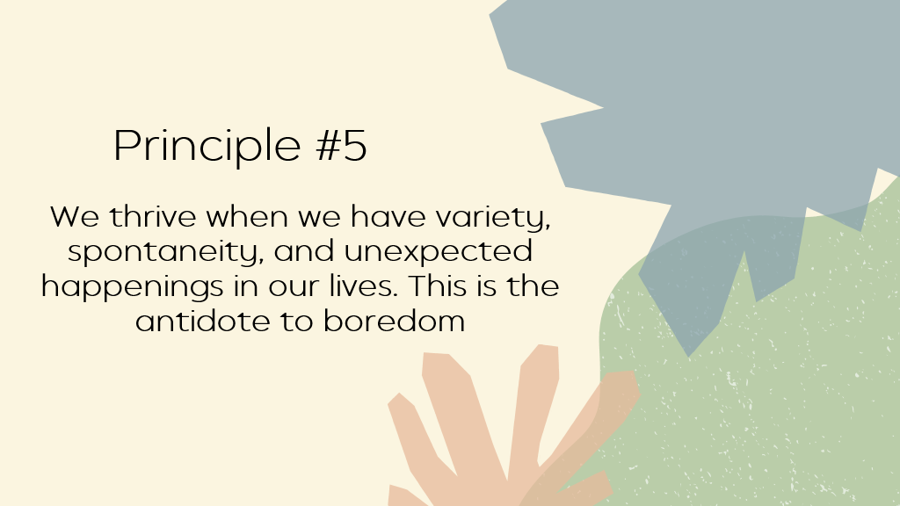

Slide 39
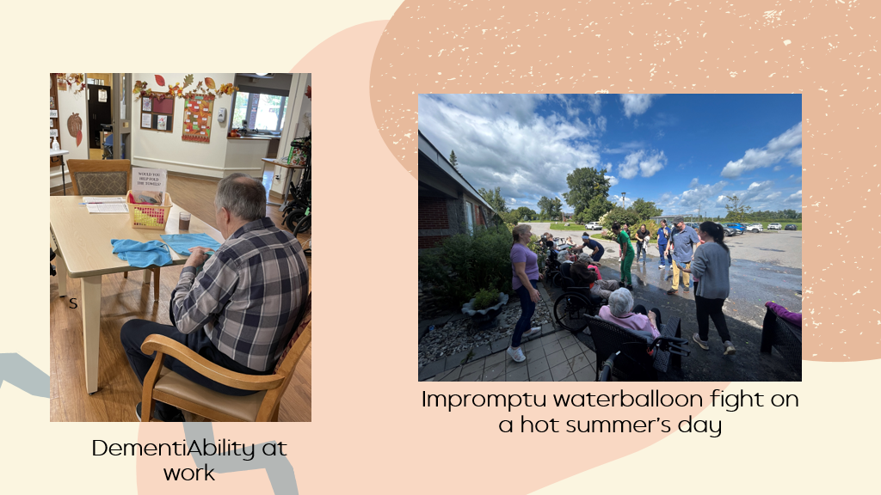

Slide 40
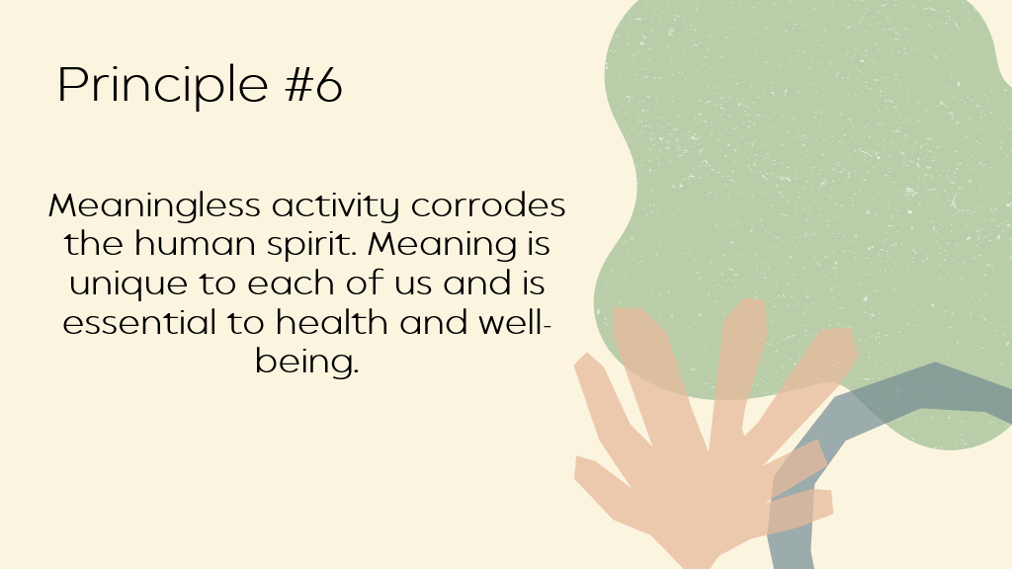

Slide 41
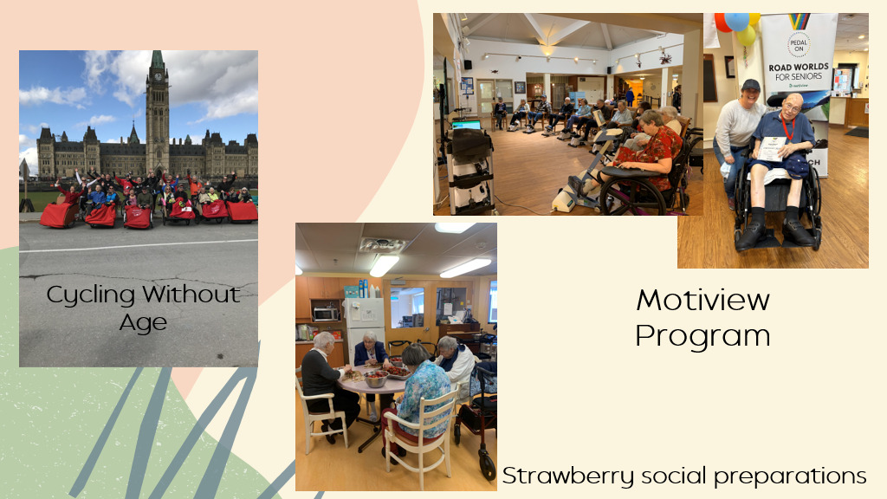

Slide 42
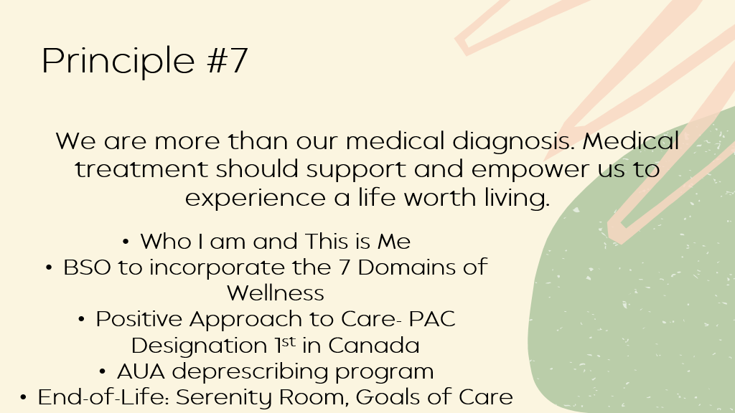

Slide 43
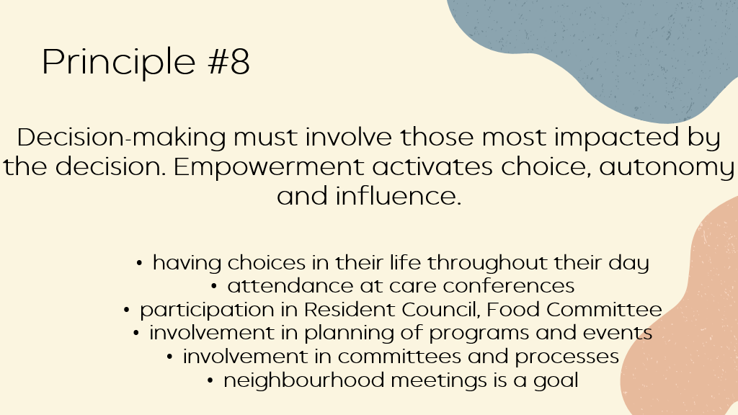

Slide 44
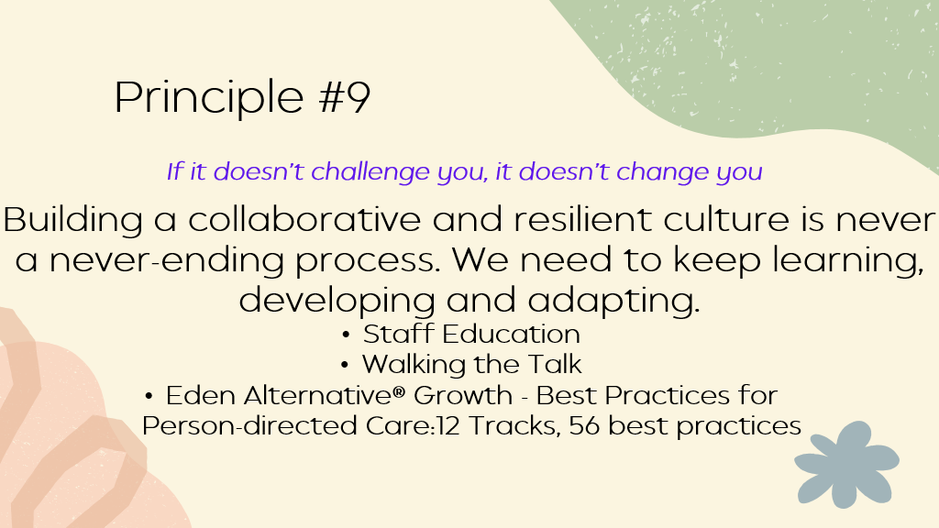

Slide 45
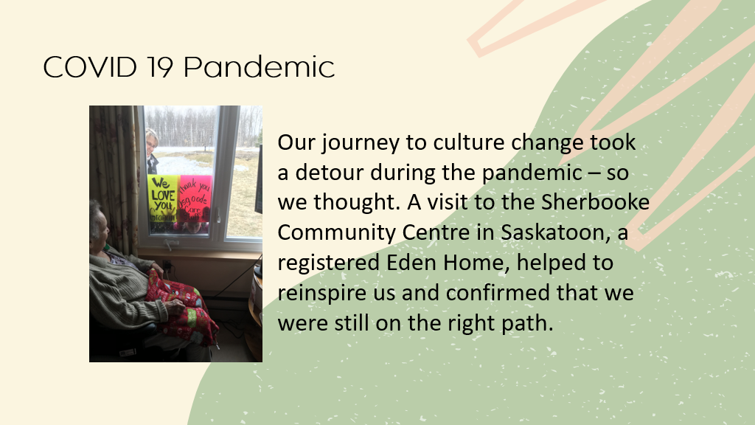

Slide 46
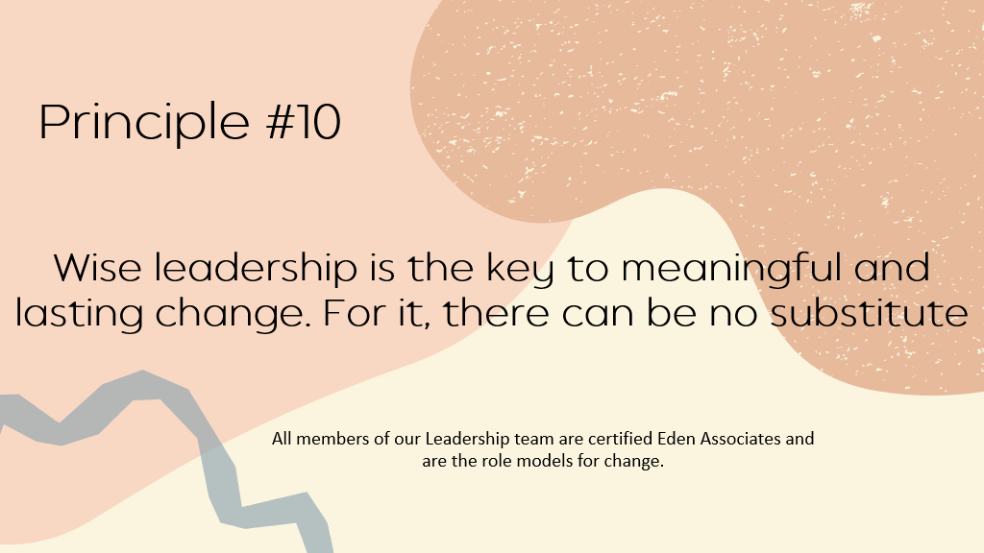

Slide 47
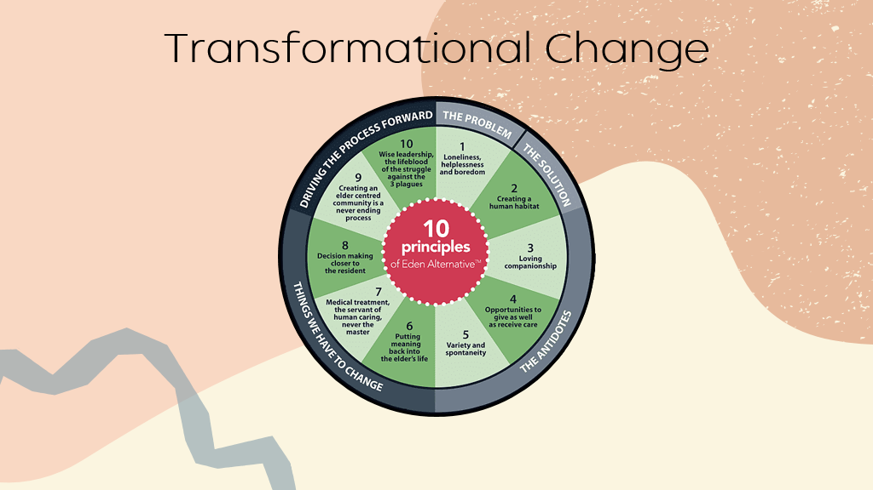

Slide 48
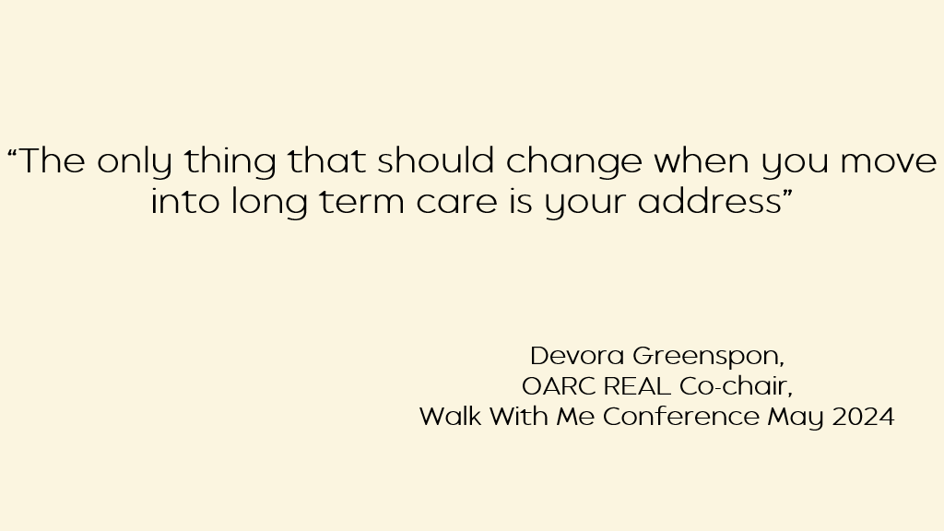

Slide 49


Slide 50
Resources
  Eden Alternative https://www.edenalt.org/
  DementiAbility https://dementiability.com/
  Cycling Without Age https://cyclingwithoutage.ca/
  Java Music Club https://javagp.com/java-music-club/
  Positive Approach to Care https://teepasnow.com/
  Tovertavel https://www.tover.care/ca-en/
  Motiview https://motiview.ca/
  LinkedSenior https://info.lifeloop.com/linked-senior

Slide 51


Slide 52


Slide 53
Resources to Learn More
‹#›
CLRI-LTC.CA

Slide 54


Book Recommendations
‹#›
CLRI-LTC.CA
Notes:
‹#›

Slide 55

CARP’s Efforts
Change LTC Now: From Institutions to Homes
  CARP has an Advocacy Working Group on Long-Term Care in Ontario
  Encouraging shift away from traditional institutional / medical and task-oriented model of care to a person-centred approach
  Learn more about the various models through the resources curated, and their blog articles
  Series of recorded webinars and links to videos
  https://changeltcnow.ca/
‹#›
CLRI-LTC.CA
Notes:
‹#›

Slide 56
Resources to Learn More about Culture Change
  Pioneer Network - Culture Change network in the US, numerous free resources available
  Working Together to Put LIVING First: A Guidebook (Research Institute for Aging)
  Re-imagining Long-Term Residential Care: An International Study of Promising Practices - Four books available (Dr Pat Armstrong and team)
‹#›
CLRI-LTC.CA
Notes:
‹#›

Slide 57
More Resources
Learn About the Different Models:
  The Eden Alternative - video: Creating Home
  Green House - video: Dare to be Different
  Meaningful Care Matters (Butterfly) - video: Peel Long Term Care: Butterfly Project
  Hogeweyk Dementia Village (The Dutch Model) - video: BBC News - Dementia patients in Dutch Village gien alternative reality
  Report: Models for Long-Term Residential Care: A Summary of the Consultants’ Report to LTC homes and Services, City of Toronto
  Resources about Ageism:
  Dr Bill Thomas - Elderhood Rising -- the dawn of a new world age (TEDx Talks)
  Rethink Aging: A Bold New Path to Life at Any Age webinar by Dan Levitt, CHE, CEO Kin Village, Adjunct Professor, Gerontology at Simon Fraser School of Nursing
‹#›
CLRI-LTC.CA
Notes:
‹#›

Slide 58




CONNECT
WITH
US
clri-ltc.ca
Ontario Centres for Learning, Research and Innovation in Long-Term Care
Ontario Centres for Learning, Research and Innovation in Long-Term Care
info@clri-ltc.ca
‹#›
CLRI-LTC.CA
Notes:
If you’re interested Interested in staying up-to-date on LTC training, news, resources, and events, please visit our website and subscribe to our newsletter. You’re also welcome to follow us on LinkedIn, Facebook.

